Slide 1
ECCC Web Project
Application for Aviation Weather System
AWS & WMS

Slide 2
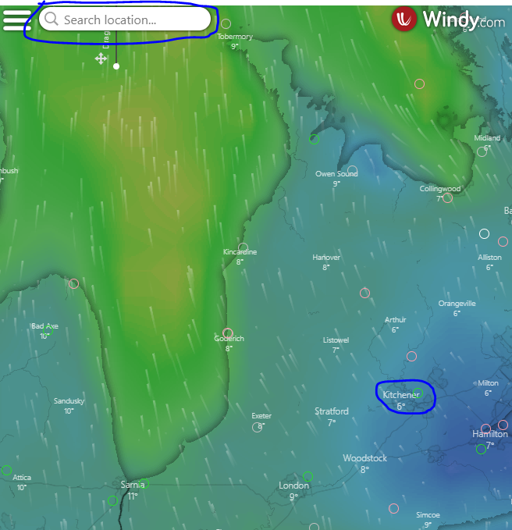
METAR & TAF
Search bar
Active search bar
Search by airport code, name, city name etc., such as google map search.
For this time, when you click the point on the map, it shows METAR & TAF (aviation weather information)

Slide 3
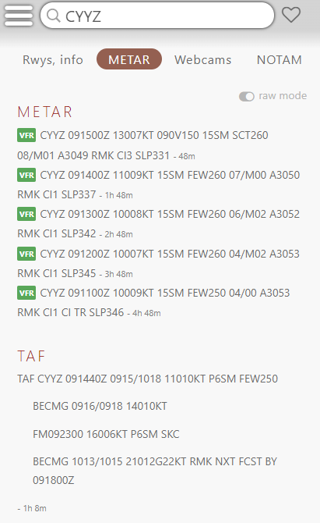
METAR & TAF
It has to appear that METAR and TAF are on the same page with several cycles.
METAR data link : https://tgftp.nws.noaa.gov/data/observations/metar/stations/
METAR Cycles data link : https://tgftp.nws.noaa.gov/data/observations/metar/cycles/
TAF data link: https://tgftp.nws.noaa.gov/data/forecasts/taf/stations/
TAF Cycles data link: https://tgftp.nws.noaa.gov/data/forecasts/taf/cycles/

Slide 4
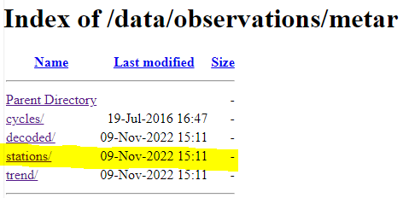
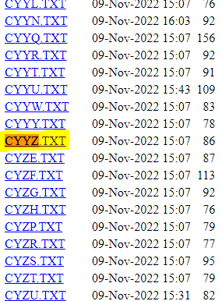

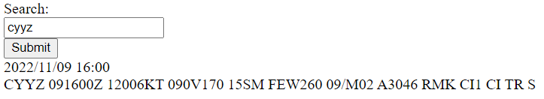
METAR & TAF(No Cycles)
Currently (without use Cycles)

Slide 5
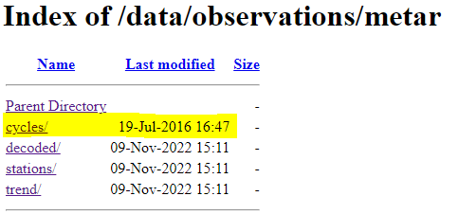
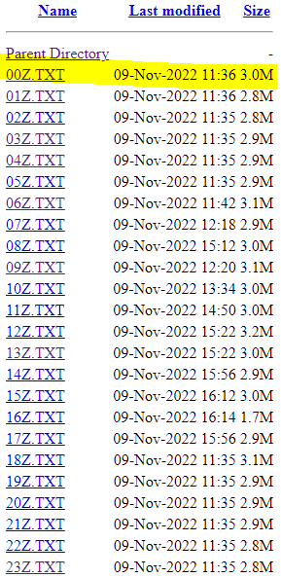
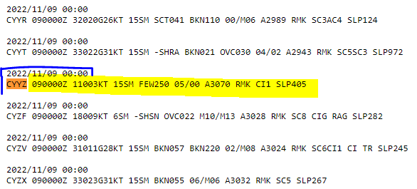
METAR & TAF(With Cycles & expect)
METAR Cycles are every hours
When you click the every hours link, it shows every airport; however, it has to show only the same airport code TAF information. But most importantly, it has to show all the hours on the same page.
The example is next page.

Slide 6

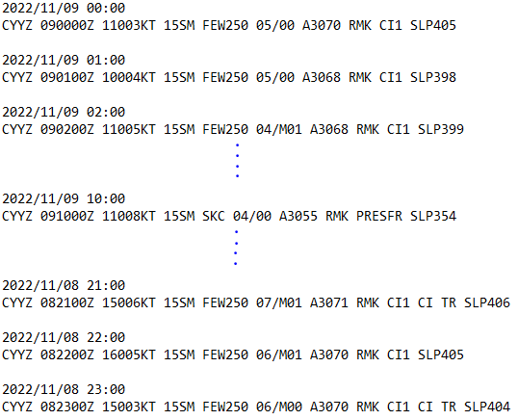
METAR Shows Expect
Search - > it all appears METAR all the hours we want to search by airport code, or name.

Slide 7
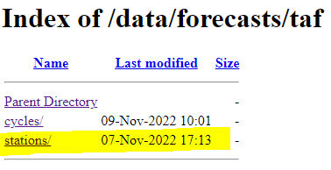
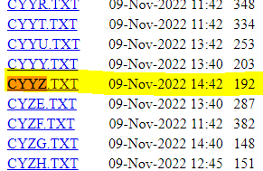
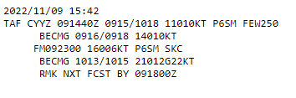
TAF Shows Expect
https://tgftp.nws.noaa.gov/data/forecasts/taf/
TAF does not need to show every cycle but only the current cycle

Slide 8
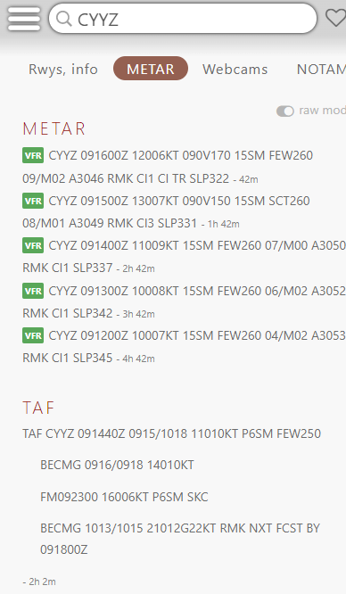
METAR & TAF Final Result

